Slide 1
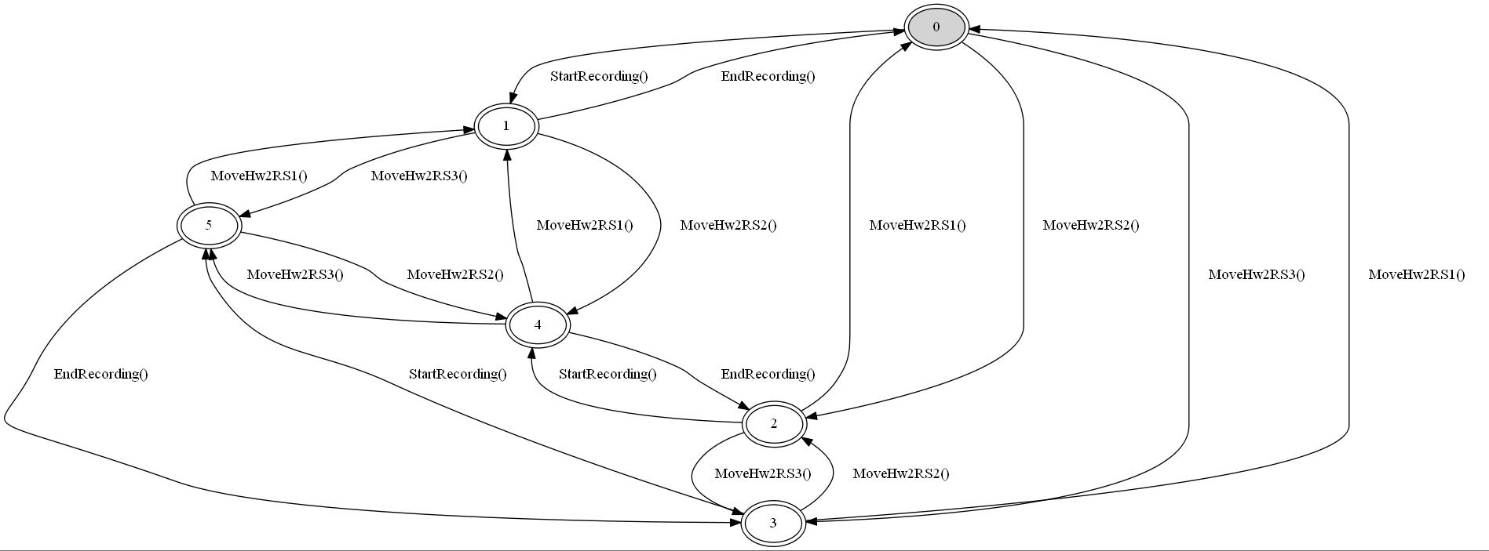

A practical example
Niels Sander Christensen, Sofia 2016
Notes:
Thanks for inviting me, I am honored to be here. I hope you will find my presentation useful, or at least interesting.
I am going to spend some time introducing the problem. Based on that I will describe how that lead me to Model based testing.
Then I am going to dig into details of Model based testing, and how to integrate that with test automation.
I will also touch on a few related tools to consider, and wrap up with some results.

Slide 2
Agenda
The Setup(4), the problem(1) and how I ended at Model based testing(2)
Model Based Testing – Digging In
  Basic Flow (1)
  Model Implementation (2)
  Generating Test Cases (4)
Other Related Tools (1)
A Little On Hooking Up To Automation Framework (2)
Notes On Validation (2)
Results (1)
Links (1)
Notes:
Numbers in () represents the number of slides on the subject

Slide 3

The Setup
milestone surveillance
Recorder
Recorder
Smart Client
Management Client
Archiving
Rules
Record on motion
Resolution
Notes:
milestone delivers the software to handle lots of cameras.
Two main parts are the smart client where the operators can see what the cameras deliver, both live and old recordings

Slide 4
The Feature
milestone surveillance
Recorder
Recorder
Smart Client
Management Client
Archiving
Rules
Record on motion
Resolution
Notes:
The feature we tested was an ability to move a camera from one recording server to another.
The settings for the camera must be preserved
Existing recordings must be handled
The impact on operators watching live or old recordings must be minimal

Slide 5
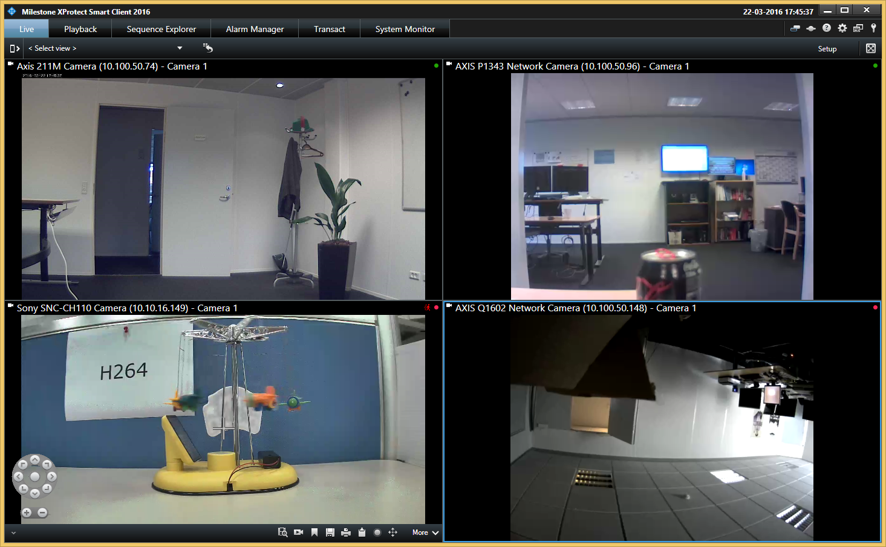
Milestone Smart Client - Live
Notes:
Example of how the live view loooks

Slide 6
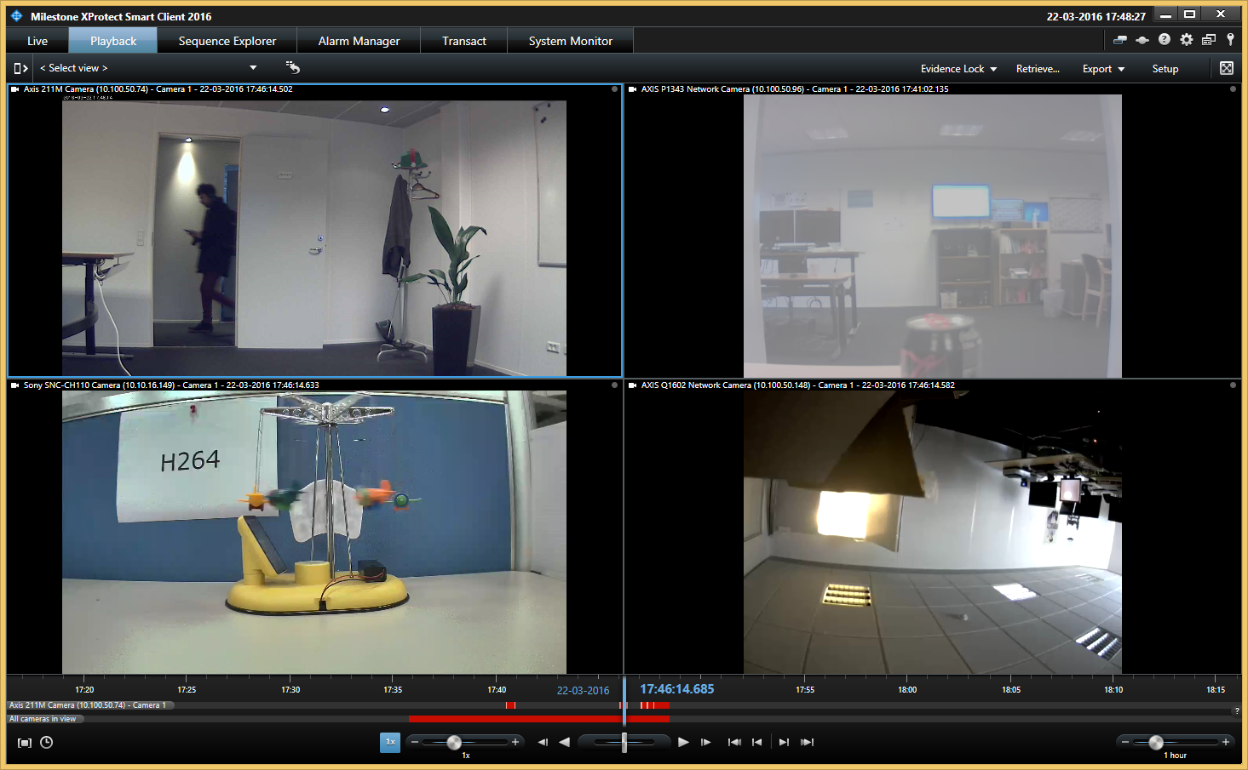
milestone Smart Client - Playback
Notes:
Example of how old recordings are presented.
You can see the timeline and the video from a specific point in time, or you can play recordings

Slide 7
The problem
Move hardware crashes under varying conditions – sometimes hard to reproduce
1st approach: Repeat many times a simple flow that moves hardware while looking for crashes
  Move hardware using wizard – 100 times
  Move hardware while in playback and stop & start recording server – 6 steps repeated 300 times
  Results: 6-8 different crashes – and counting
What about other flows and additional factors?
  Move while recording
  Move while watching live in smart client
  Move while watching old recordings
  Play recordings from an earlier recorder

Slide 8
Model Description: States & State Machines
Hardware Recording Server
RS1
RS2
RS3
Smart Client
Closed
Running
Recording
Ongoing
Stopped
Smart Client Display
Live
Playback_playing
Playback_none
Evidence Lock
Lock_exists
Lock_none
State combinations: 2*3*2*3*2 = 72
Transitions between states: 504
Model based testing
Notes:
Lists the relevant aspects/components/features
Represent each as a state machine with the relevant states
Figuring this one out can take some time, you’re determining and defining the relevant abstraction

Slide 9
Model Description: Actions
Hardware Recording Server
RS1
RS2
RS3
Smart Client
Closed
Running
Recording
Ongoing
Stopped
Smart Client Display
Live
Playback_playing
Playback_none
Evidence Lock
Lock_exists
Lock_none
Actions
Start_SC
Stop_SC
Actions
MoveTo_RS1
MoveTo_RS2
MoveTo_RS3
Actions
Start_rec
Stop_rec
Actions
Goto_Live | SC_running
Goto_Playback | SC_running
Goto_Playback_Play | SC_running
Actions
Add_Lock | SC_running && (Playback_playing ||Playback_none)
Delete_Lock | SC_running && (Playback_playing ||Playback_none)
12 Actions in total – looks feasible
Notes:
Determining the actions is typically simple
In this case it looks feasible – so lets look deeper into model based testing

Slide 10
Model Based Test – Basic Flow
Model implementationC# dll
Test Automation Interface
Model description
MBT tool (NModel)
Test Automation test case
Generated test cases
Notes:
This is the basic flow of a typical models based testing setup, using NModel as an example
Let us look deeper into the components

Slide 11
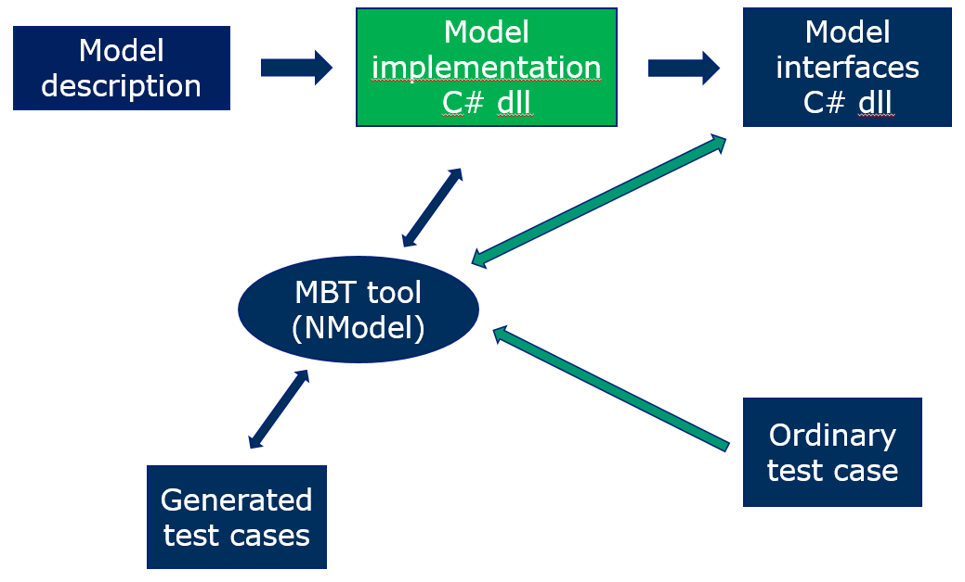
Model Implementation
Depends on the tool
I chose NModel because it is simple to use, open source and I knew it from earlier
NModel can generate test cases that visit each state combination and take each transition at least once
    Before doing so it eliminates all paths to dead states, then traverses the remaining paths using a postman tour that covers the entire graph of the FSM in the minimum number of steps
The model is implemented as a C# project

Slide 12
Model Implementation: C#
// State machines with states
public enum RecordingServer { Server1, Server2, Server3 };
public enum Recording { Ongoing, Stopped };
public enum SmartClientState { Closed, Running };
public enum SmartClientDisplay { Live, PlayingNone, Playing };
public enum EvidenceLock { Exist, None };
// Combined state space: 3*2*2*3*2 = 72
public static class MoveHardwareStates
{
// State machines, initial states
public static RecordingServer serverWithHardware = RecordingServer.Server1;
public static Recording recordingStatus = Recording.Stopped;
public static SmartClientState smartClient = SmartClientState.Closed;
public static SmartClientDisplay smartClientDisplay = SmartClientDisplay.Live;
public static EvidenceLock lockStatus = EvidenceLock.None;
}
public static class MoveHardwareModelDefinition
{
// Action methods. Enabling conditions are "public static bool <ActionMethodName>Enabled()“
// Recording Server related actions
public static bool MoveHardwareToRecordingServer1Enabled()
{
return (MoveHardwareStates.serverWithHardware != RecordingServer.Server1);
}
[Action]
public static void MoveHardwareToRecordingServer1()
{
MoveHardwareStates.serverWithHardware = RecordingServer.Server1;
}
Notes:
An enum for each of the state machines, each containing all the states of the state machine
An object storing the current state of the state machine
A coupling tying an action to a change of state
A condition that has to be fulfilled for the action to be done

Slide 13
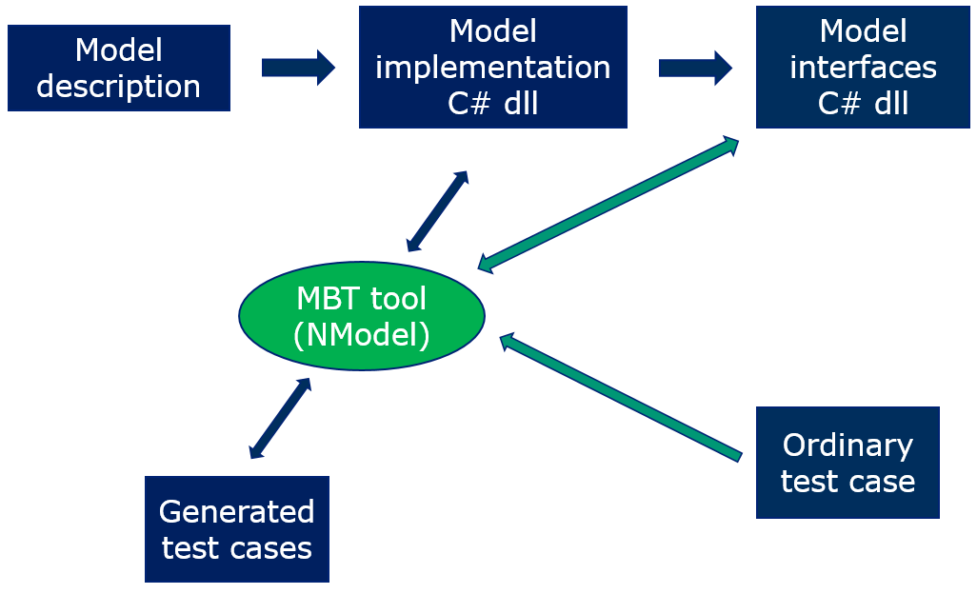
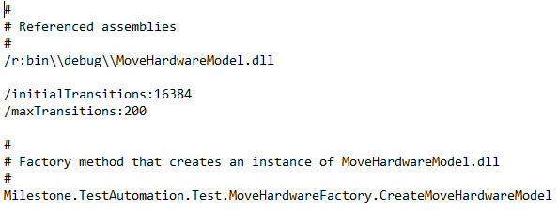
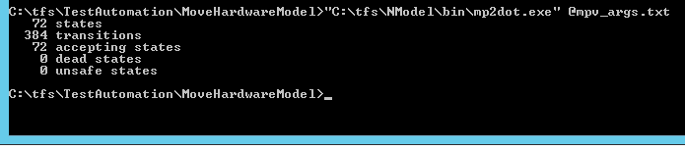
Running NModel - Analyze
Command Line Tools
Analyze model:
  mp2dot.exe @mpv_args.txt
Notes:
Simple command line tool
Old fashioned I know, but it works
I have only used the three upper outputs
The 384 is a considerable reduction from the 504 transitions that would have been possible had there not been restrictions on when an action will shift states
{Simply stated dead states are states from which no action will get you out, and unsafe states are states that you cannot get into. Getting the tool to find those requires additional modelling}

Slide 14
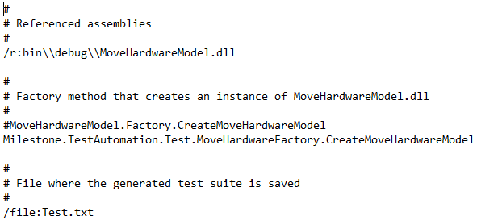
Running NModel – Generate Tests
Generate test cases: otg.exe @otg-args.txt
Notes:
This is useful when you want to see the test cases that are generated and the details of what they do

Slide 15
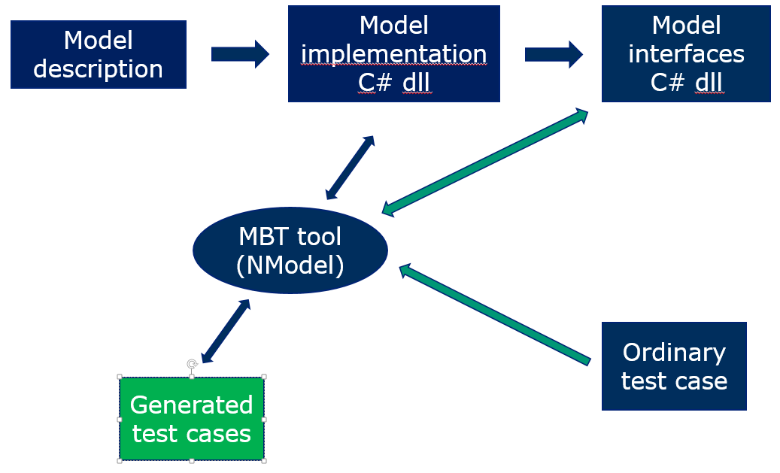
Generated Test Cases (MBT internal)
TestSuite(
TestCase(
SmartClientStart(),
MoveHardwareToRecordingServer2(),
SmartClientPlayingNone(),
MoveHardwareToRecordingServer1(),
SmartClientPlaying(),
SmartClientLive(),
SmartClientPlayingNone(),
StartRecording(),
SmartClientLive(),
MoveHardwareToRecordingServer3(),
SmartClientPlayingNone(),
SmartClientLive(),
SmartClientClose(),
MoveHardwareToRecordingServer1(),
MoveHardwareToRecordingServer3(),
SmartClientStart(),
MoveHardwareToRecordingServer2(),
SmartClientPlaying(),
MoveHardwareToRecordingServer1(),
EndRecording(),
SmartClientPlayingNone(),
SmartClientClose(),
MoveHardwareToRecordingServer2(),
StartRecording(),
MoveHardwareToRecordingServer1(),
EndRecording(),
SmartClientStart(),
LockAdd(),
Notes:
To illustrate what the test cases do

Slide 16
Tool Result Summary
  Result:
    All 72 states can be reached
    384 transitions possible (out of 504)
    1 (MBT) test case with 384 steps (!) (not counting setup)
Notes:
A step is one of the 12 actions identified earlier

Slide 17
Other Related Tools
SpecExplorer
  A successor of NModel. Can handle that there is no upper limit on the number of states in a state machine (E.g. no hardcoding of how many recording severs we use)
  Is a plug-in to Visual Studio
  Does not work on VS2012 or newer (!)
Pairwise testing (PICT)
  Reduce number of combinations to test by only targeting all pairwise combinations instead of all combinations
  Example:
    We have 2, 3, 2, 3, and 2 states in the 5 state machines, resulting in a total of 72 combinations
    Pairwise coverage can be achieved with 10 combinations
Notes:
The fact that the plug-in has not been carried up to newer versions of VS shows that model based testing is not widely used
Which probably also means it is not widely useful. But in some cases like this it does make sense!

Slide 18
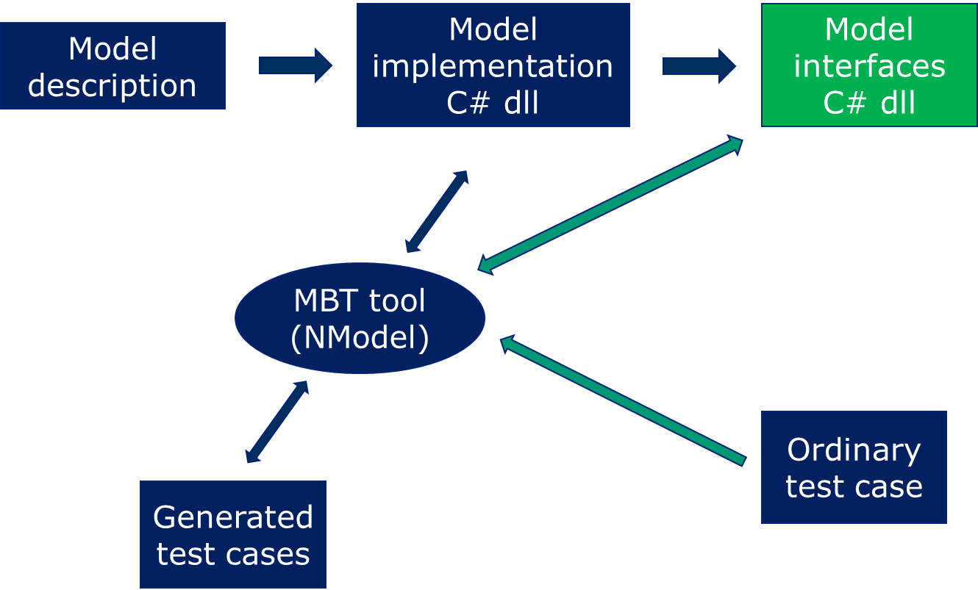
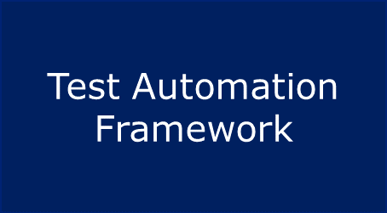
Interface: Connecting to test framework
Connect the model with the application through the automation code
  Stepper
  Reset
  Actions
  Setup
  Validation
Notes:
Test automation framework is an existing framework, not related to model based testing as such.
A test case was created in the test automation framework, the test case makes NModel run the tests
An interface is required so that the relevant action happens when NModel asks for it
On to see some code details

Slide 19

Implement: Stepper
public class MoveHardwareStepper : Istepper
{
private MoveHWModelSupport modelSupport = new MoveHWModelSupport();
public CompoundTerm DoAction(CompoundTerm action)
{
switch (action.FunctionSymbol.ToString())
{
case ("MoveHardwareToRecordingServer1"):
modelSupport.MoveHardwareToRecordingServer1();
break;
case …
default:
throw new ArgumentOutOfRangeException("Unexpected action " + action);
}
modelSupport.CheckAfterEachAction(action.FunctionSymbol.ToString());
return null;
}
public void Reset()
{
modelSupport.Reset();
}
public static IStepper Make()
{
return new MoveHardwareStepper();
}
}
Notes:
This is the core class that NModel uses to execute the actions
Quite simple code.
The modelSupport class uses existing test automation code to carry out the actions

Slide 20
Validation - General
/// <summary>
/// Method called after each action
/// - Checks whether crashes have appeared
/// </summary>
public void CheckAfterEachAction(string action)
{
bool crashEncountered = false;
// Allow the system a few seconds to settle down
System.Threading.Thread.Sleep(2000);
foreach (KeyValuePair<RecordingServer, RecorderHost> recorderHost in serverStore.RecorderHosts)
{
if (recorderHost.Value.QueryForCrashes(DateTime.Now.AddDays(-1)) != 0)
{
Log.WriteLine("CRASH encountered on {0}", recorderHost.Value.ComputerName);
Log.WriteLine("Action: {0}", action);
LogCurrentStates();
crashEncountered = true;
}
}
Assert.IsFalse(crashEncountered, "CRASH encountered");
}
Notes:
This is what we chose to validate: a check for crashes
It has later been enhanced with check of log file messages

Slide 21
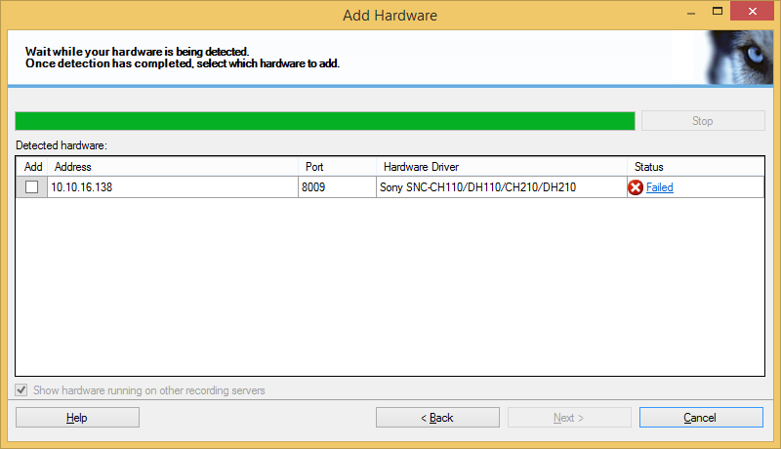
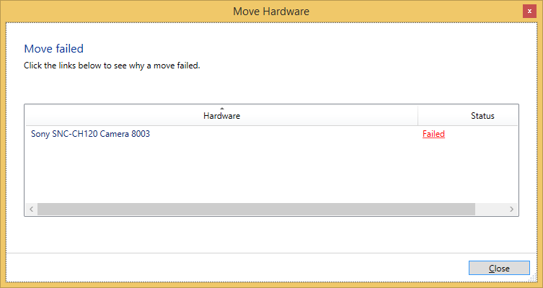
Validation -Specific
Ignore flow breaking failures
Check for failures that do not break the flow
Notes:
Flow breaking failures will pop up anyway so no need to write extra code to check for those

Slide 22
Results
Took ~6 weeks to implement, including finding & learning the tool
  Thanks & credit to Bence Makkos & Rune Holstvig for implementing setup & actions
Run ~300 times. Runtime 71 minutes, excl. setup
3 bugs found
Issues: Stability, both of the feature (good) and of the test automation (not so good)
Latest use: Look for a specific occasional error

Slide 23
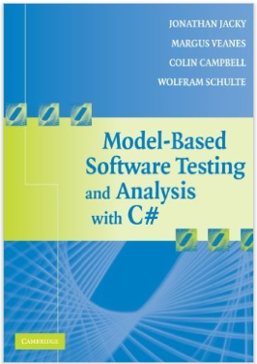
Links
Nmodel: http://nmodel.codeplex.com
Book:
  Model-based Software Testing and Analysis with C#
  Jonathan Jacky, Margus Veanes, Colin Campbell, Wolfram Schulte
  Cambridge University Press, 2008 (available December 2007)
Pict, pairwise testing tool
  Open Source
  Download

Slide 24
Questions?
Please ask

Slide 25
Model Description: Action Considerations
Actions
Start_SC
Stop_SC
Actions
MoveTo_RS1
MoveTo_RS2
MoveTo_RS3
Actions
Start_rec
Stop_rec
Actions
Goto_Live | SC_running
Goto_Playback | SC_running
Goto_Playback_Play | SC_running
Actions
Add_Lock | SC_running && (Playback_playing ||Playback_none)
Delete_Lock | SC_running && (Playback_playing ||Playback_none)
Actions that cannot happen, like when a button is not visible, should be left out
Actions that provoke an error message can be included
Verifications can be more or less exhaustive
  Start out simple, e.g. looking for crashes after any action
  Later add more detailed checks of action success
Notes:
In many cases a failed action will break the test execution anyway so concentrate on the failures that do not break the execution.
It requires some cumbersome automation code to handle that the model can try to push a button that is not there and should not fail when doing that so the recommendation is not to try
Expected error messages can be checked but to keep the model small avoid this unless they depend on several state machines.

Slide 26
Implement: Reset
/// <summary>
/// Called from NMOdel/stepper after each test case.
/// Checks for failures and resets system to starting states.
/// </summary>
/// <param name="resetWithoutCheckpoints">
/// True means the system is reset without using checkpoint, false resets using checkpoints
/// </param>
public void Reset(bool resetWithoutCheckpoints = true)
{
if (MilestoneNModelCommandLine.NModelTestFailed(testCaseCounter))
{
LogCurrentStates();
Assert.Fail("A failure was encountered. See previous logs for details");
}
using (Log.Section(resetWithoutCheckpoints ? "Reset without checkpoints" : "Reset using checkpoints"))
{
if (resetWithoutCheckpoints)
{
if (MoveHardwareStates.serverWithHardware != RecordingServer.Server1)
MoveHardwareToRecordingServer1();
.....
SetDefaultStates();
Log.SectionOutcome("Reset after test {0} completed", (testCaseCounter++).ToString());
}
}
Notes:
This is rather specific to our implementation but it illustrates one issue:
If you reset without using a brute force approach like restoring a checkpoint then you need to call relevant actions to bring the system into the default or starting state.

Slide 27
Implement: Actions
private void MoveHardwareToRecordingServer(RecordingServer target)
{
Vmo.RecordingServer toRecServ = serverStore.VmoRecordingServers[target];
hardwareToMove.MoveHardwareUsingVmo(toRecServ, toRecServ.RecordingStorages.First(), false);
}
public void MoveHardwareToRecordingServer1()
{
if (MoveHardwareModelDefinition.MoveHardwareToRecordingServer1Enabled())
{
MoveHardwareToRecordingServer(RecordingServer.Server1);
Log.WriteLine("Move HW to RS1");
MoveHardwareStates.serverWithHardware = RecordingServer.Server1;
}
else Assert.Fail("Recording Server 1 already contains the hardware");
}
public void MoveHardwareToRecordingServer2()
{
if (MoveHardwareModelDefinition.MoveHardwareToRecordingServer2Enabled())
{
MoveHardwareToRecordingServer(RecordingServer.Server2);
Log.WriteLine("Move HW to RS2");
MoveHardwareStates.serverWithHardware = RecordingServer.Server2;
}
else Assert.Fail("Recording Server 2 already contains the hardware");
}
Notes:
Note that MoveHardwareToRecordingServer1Enabled() is reused from the model definition

Slide 28
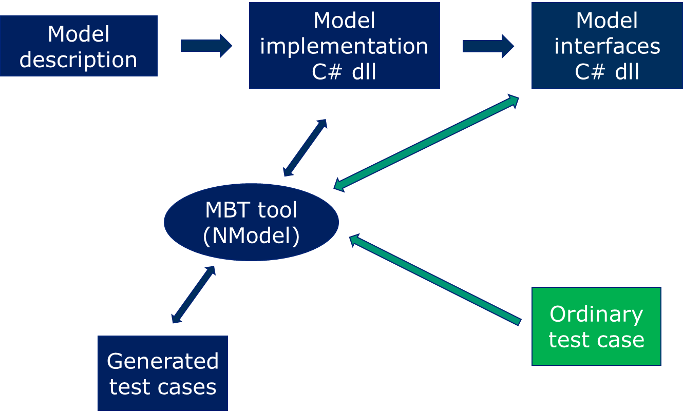
Running The Tests
One Über test case
[Category(TestCategories.Stability)]
[Test]
public static void AModelBasedStabilityTest()
{
// Create tests that cover MoveHardware states & transitions
OfflineTestGenerator.RunWithCommandLineArguments(MilestoneNModelCommandLine.GenerateModelArguments("MoveHardware"));
ManagementClient.EnsureIsInstalled(HostConfiguration.Values.InstallerFolder);
// Run tests that cover MoveHardware states & transitions
ConformanceTester.RunWithCommandLineArguments(MilestoneNModelCommandLine.RunModelArguments("MoveHardware"));
}
Notes:
There were a few minor changes to the NModel source code, but they were really minor.

