Slide 1
How and why we should use Behat?

Slide 2

About me
Bozhidar Boshnakov
QA Department Manager @ FFW
bozhidar.boshnakov@gmail.com
Drupal.org – bboshnakov
Linkedin.com/in/bboshnakov
Notes:
WEB DEVELOPMENT!!!!

Slide 3
Agenda
BDD – Behaviour-Driven Development
Gherkin
Behat
Mink
Notes:
WEB DEVELOPMENT!!!!

Slide 4
SMART PEOPLE
Can make progress …
… without process
This is not a good thing!

Slide 5
Professionals
Design, plan and prepare first
… then do the work
This produces better results FASTER!

Slide 6
What is Behaviour-Driven Development? (BBD)
Notes:
“BDD is about implementing an application by describing its behavior from the perspective of its stakeholders.” – Dan North
The original developer of BDD (Dan North) came up with the notion of BDD because he was dissatisfied with the lack of any specification within TDD of what should be tested and how.
BDD – Second generation of agile methodology
User stories
Domain-Driven Development
Extreme Programmin
TDD
Acceptance Driven Test Planning
Continuous integration

Slide 7
“BDD is about implementing an application by describing its behavior from the perspective of its stakeholders.” – Dan North
Notes:
“BDD is about implementing an application by describing its behavior from the perspective of its stakeholders.” – Dan North
The original developer of BDD (Dan North) came up with the notion of BDD because he was dissatisfied with the lack of any specification within TDD of what should be tested and how.
BDD – Second generation of agile methodology
User stories
Domain-Driven Development
Extreme Programmin
TDD
Acceptance Driven Test Planning
Continuous integration

Slide 8
“BDD is when you use examples in conversations to illustrate behaviour.” – Liz Keogh
Notes:
“BDD is about implementing an application by describing its behavior from the perspective of its stakeholders.” – Dan North
The original developer of BDD (Dan North) came up with the notion of BDD because he was dissatisfied with the lack of any specification within TDD of what should be tested and how.
BDD – Second generation of agile methodology
User stories
Domain-Driven Development
Extreme Programmin
TDD
Acceptance Driven Test Planning
Continuous integration

Slide 9
BDD is about delivering
software that matters.
Notes:
“BDD is about implementing an application by describing its behavior from the perspective of its stakeholders.” – Dan North
The original developer of BDD (Dan North) came up with the notion of BDD because he was dissatisfied with the lack of any specification within TDD of what should be tested and how.
BDD – Second generation of agile methodology
User stories
Domain-Driven Development
Extreme Programmin
TDD
Acceptance Driven Test Planning
Continuous integration

Slide 10
THE STANDISH GROUP
Feature usage in enterprise software
Notes:
A very oft-cited metric is that 64 percent of features in products are “rarely or never used.” The source for this claim was Jim Johnson, chairman of the Standish Group, who presented it in a keynote at the XP 2002 conference in Sardinia. The data Johnson presented can be seen in the following chart.

Slide 11
WE DELIVER WASTE
IN FORM OF THE FEATURES

Slide 12
Your client
does not care
about your scope

Slide 13
Your client
does not care
about his budget

Slide 14
Your client
only care
about his business

Slide 15
Your client worries about
his budget and your scope
because you do not care
about his business

Slide 16
START TALKING!
USING THE LANGUAGE BUSINESS CAN UNDERSTAND
Notes:
Deliver software that matters.
Starting conversation is more important than documenting it
Documenting is more important the automating
Automation is a need

Slide 17
Gherkin
Gherkin is a Business Readable, Domain Specific Language created especially for behavior descriptions. It gives you the ability to remove logic details
from behavior tests.

Slide 18
Gherkin Syntax
Feature: Banana Calculator
As Bob the Banana merchant,
I want a calculator that can add the amount of bananas so that I can know how many bananas I currently have
Scenario: Will add 2 banana amounts
Given I have 3 Bananas
When I add 5 Bananas
Then I should have 8 Banana

Slide 19


This is where
and come in

Slide 20
Behat is an open source behavior-driven development framework
for PHP 5.3+.

Slide 21
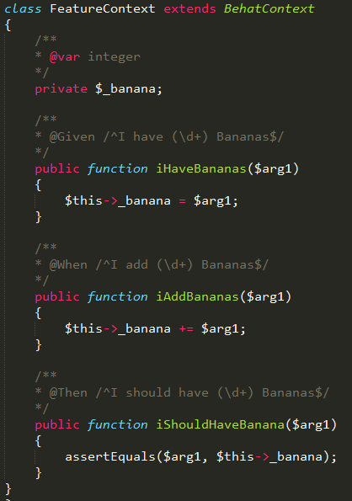
Notes:
It is impossible to explain the whole framework for one session.

Slide 22
One of the most important parts in the web is a browser. A browser is the window through which web application users interact with the application and other users.
Notes:
There’s huge amount of browser emulators out there, like Goutte, Selenium, Sahi and others. They all do the same job, but do it very differently. They behave differently and have very different API’s. But, what’s more important - there’s actually 2 completely different types of browser emulators out there:
Headless browser emulators
Browser controllers

Slide 23
Headless browser emulators
?
Browser controllers
Notes:
First type browsers are simple pure HTTP specification implementations, likeGoutte. Those browser emulators send a real HTTP requests against an application and parse the response content. They are very simple to run and configure, because this type of emulators can be written in any available programming language and can be run through console on servers without GUI. Headless emulators have both, advantages and disadvantages. Advantages are simplicity, speed and ability to run it without the need in real browser. But this type of browsers have one big disadvantage - they have no JS/AJAX support. So, you can’t test your rich GUI web applications with headless browsers.
Second browser emulators type are browser controllers. Those emulators aims to control the real browser. That’s right, a program to control another program. Browser controllers simulate user interactions on browser and are able to retrieve actual information from current browser page. Selenium and Sahi are two most famous browser controllers. The main advantage of browser controllers usage is the support for JS/AJAX interactions on page. Disadvantage is that such browser emulators require installed browser, extra configuration are usually much slower than headless counterparts.

Slide 24
Selenium WebDriver
Control the Browser – Session
Cookies and Headers management
HTTP Authentication
Traverse the Page - Selectors
Manipulate the Page

Slide 25

PhantomJS
Full web stack
No browser required!
Notes:
PhantomJS is a headless WebKit scriptable with a JavaScript API. It has fast andnative support for various web standards: DOM handling, CSS selector, JSON, Canvas, and SVG.

Slide 26
Behat.yml
All configuration happens inside a single configuration file in the
YAML format.

Slide 27
Why Behat?
Behat is built upon BDD
Behat is flexible
Behat is open-source
Behat is a challenge
Notes:
For the most important thing was its integration with Drupal.

Slide 28
What is the difference between TDD and BBD?
Notes:
http://joshldavis.com/2013/05/27/difference-between-tdd-and-bdd/

Slide 29


Slide 30
Thank you!
www.qachallengeaccepted.com

